Slide 1
CSCE 5215 Machine Learning Final Project
Analyzing the Impact of Weather Conditions on
Uber and Lyft Ride Services.
Group | 12
Name | ID
Sijo Rejigeorge | 11708233
Kishan Kumar Zalavadia | 11685261
Poojitha Gorantla | 11597766
Valapadasu Uday Bhaskar | 11696364

Slide 2
Introduction
Ride-sharing services, such as Uber and Lyft, have revolutionized urban transportation. This project delves into the analysis of ride-share data to uncover patterns and trends in the usage of Uber and Lyft, aiming to provide actionable insights for optimizing logistics and improving overall service efficiency.

Slide 3
Problem Statement/Hypothesis
The weather has a huge impact on people's preference to travel around the city and the availability and reliability of the various transportation systems.
In this study we will narrow down the entire transportation system to just ride-sharing apps in and around Boston, MA.
We see how the weather could impact the computer's decision-making process on booking such services as well as their availability.

Slide 4
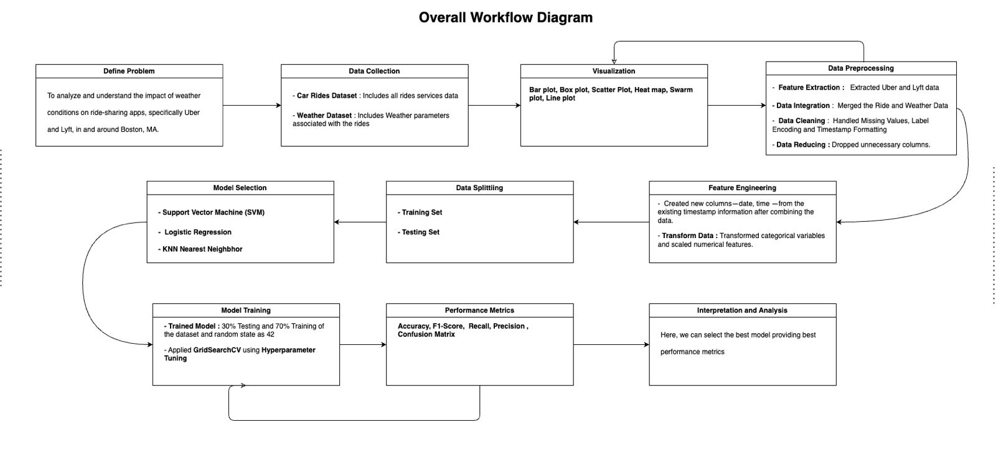
Model/Methodology Overall Workflow diagram

Slide 5
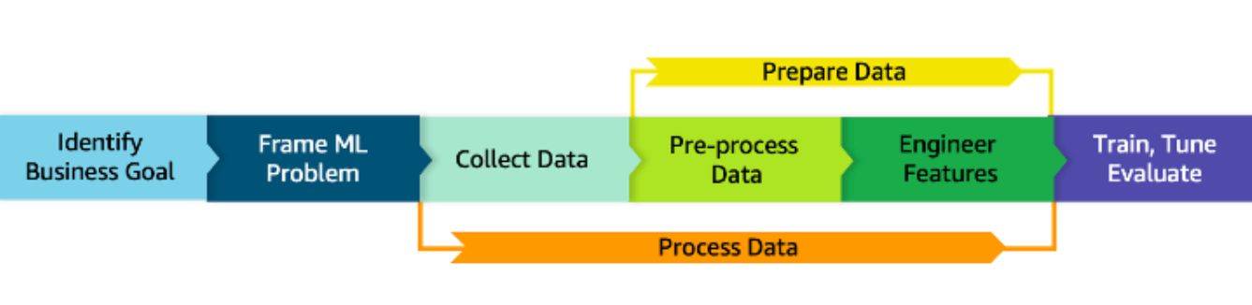
Model/Methodology
Architecture diagram

Slide 6
Dataset
Description/Representation of Dataset

Slide 7
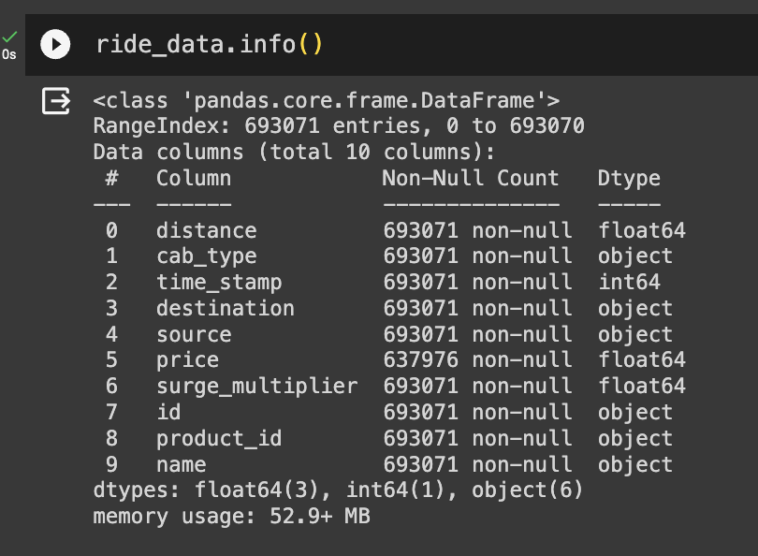
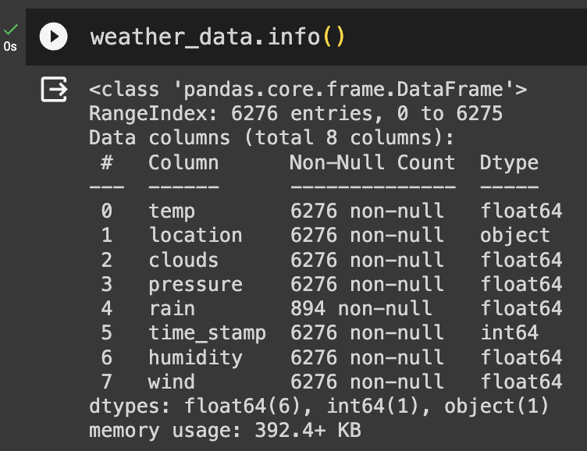
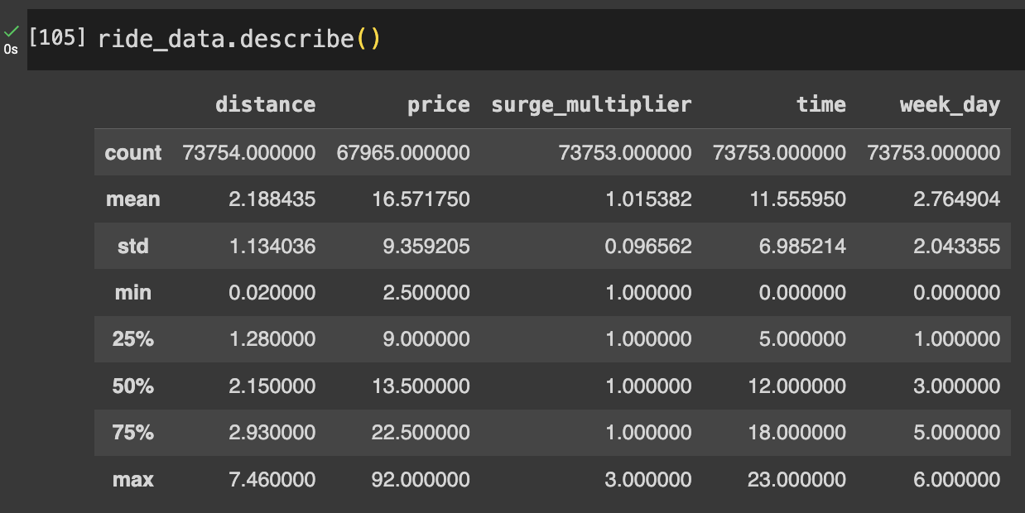
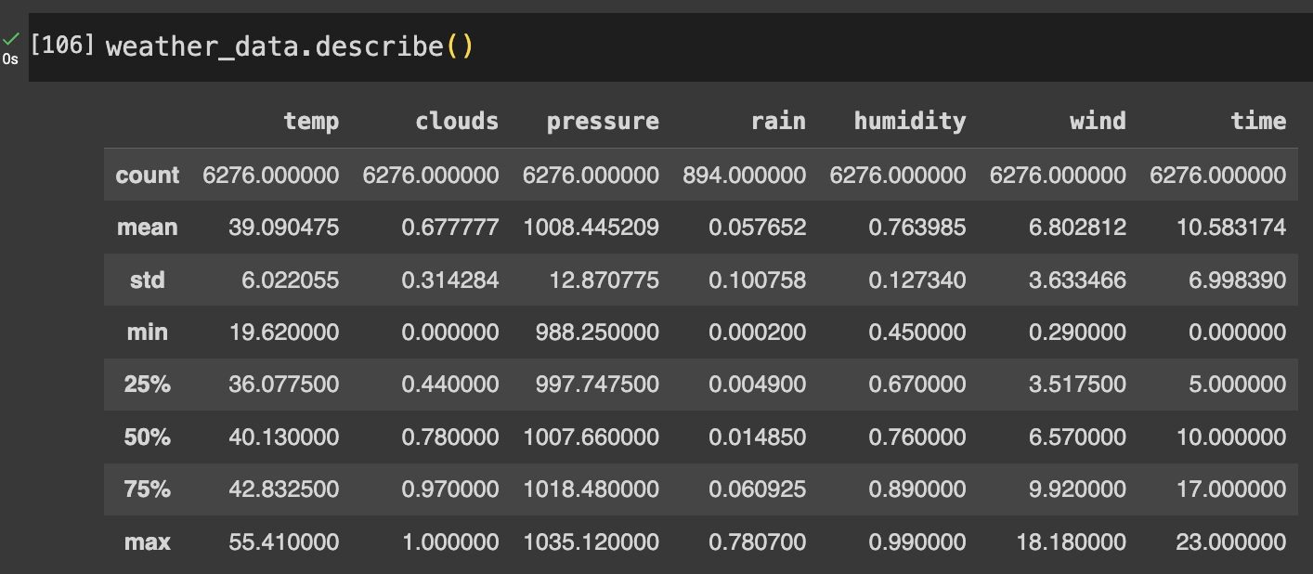
Dataset –1: Rides Dataset
Dataset – 2: Weather Dataset

Slide 8
Dataset
Design of Features/ labels
Dataset: https://www.kaggle.com/datasets/ravi72munde/uber-lyft-cab-prices

Slide 9
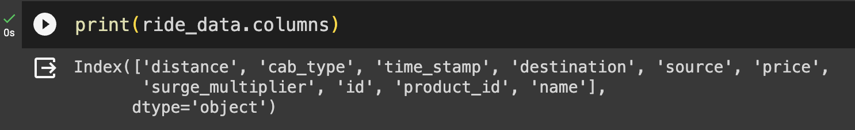
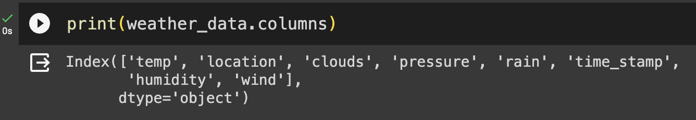
Features:
Dataset –1: Rides Dataset
Dataset – 2: Weather Dataset

Slide 10
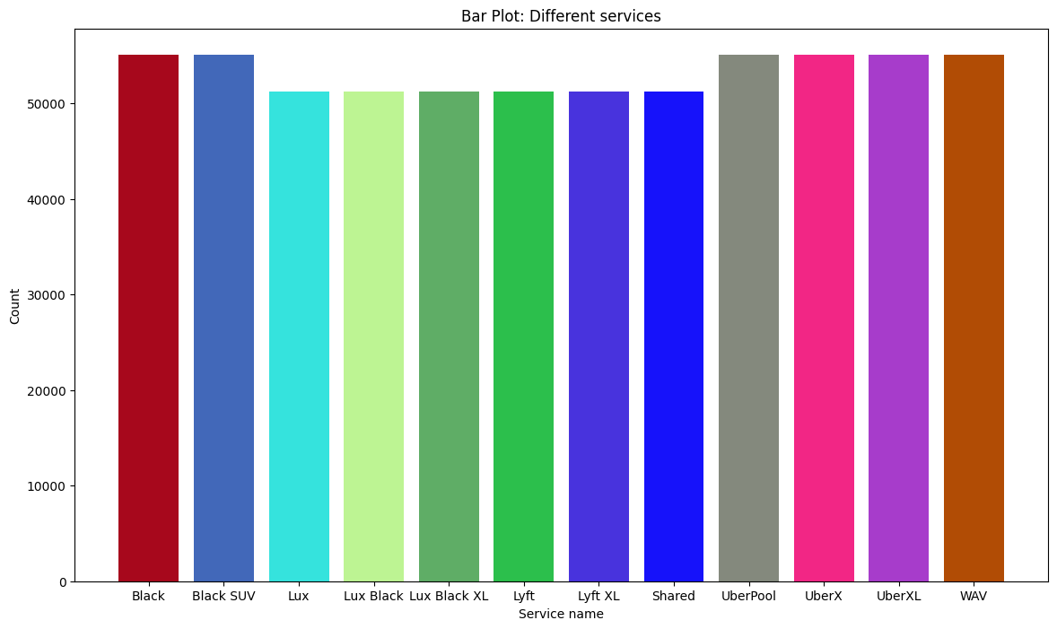
Dataset - 1: Ride Detail Data:

Slide 11
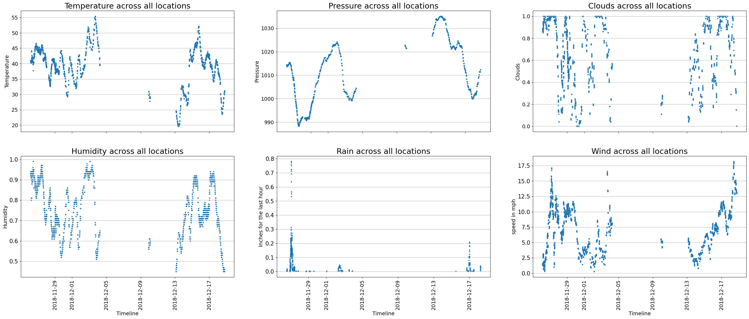
Dataset - 2: Weather Data:

Slide 12
Exploratory Data Analysis
Data Visualization

Slide 13
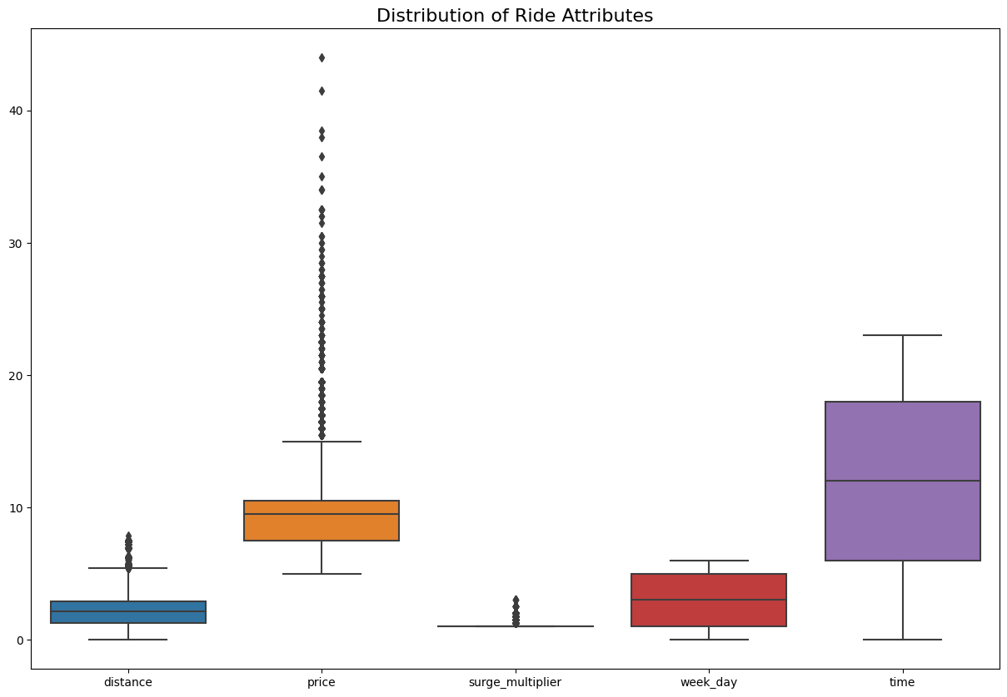
Ride Details Dataset
Why Boxplot?
Box plots helped us in identifying data points that may be outliers
- Outliers
Depiction:
The price parameter exhibits a greater number of outliers in comparison to the Surge_Multiplier and Distance parameters. On the other hand, both weekdays and time parameters do not display any outliers.

Slide 14
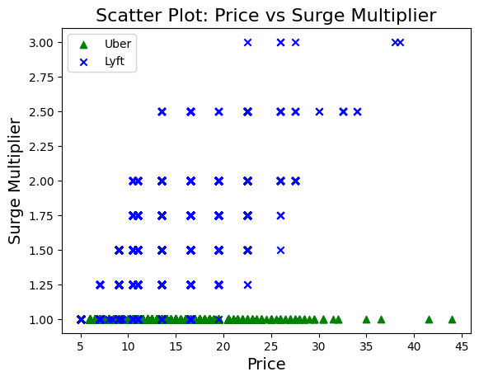
Why Scatter Plot?
Scatter plots helped us in finding correlations between Price and Surge Multiplier.
Depiction:
The chart shows how price and surge_multiplier are connected for both Lyft and Uber. Lyft is shown as blue crosses, and Uber as green triangles. What we can conclude is that there is a constant surge multiplier for Uber.

Slide 15
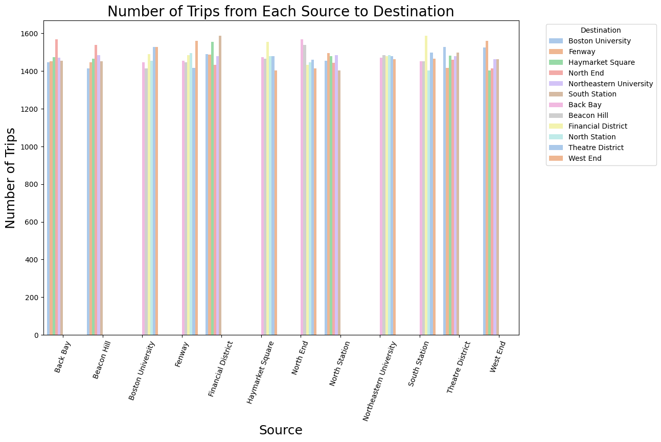
Depiction:
Helped us in identification of the visited destination from each source.

Slide 16
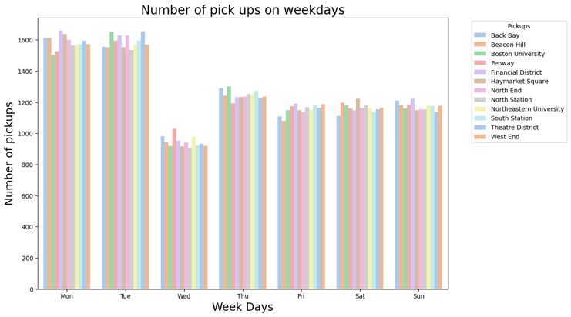
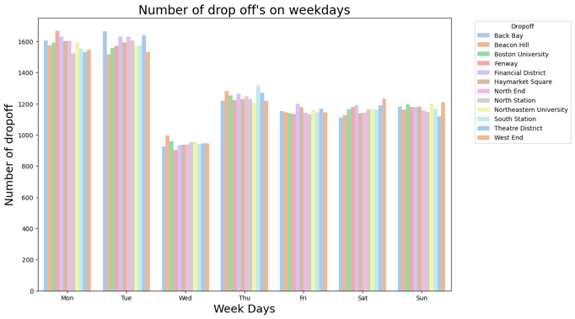
Depiction:
Count of both pickups and drop-offs for each day of the week.
It reveals a lower number of pickups and drop-offs on Wednesdays, while Mondays and Tuesdays show a higher count, indicating a notable difference in activity throughout the week.

Slide 17
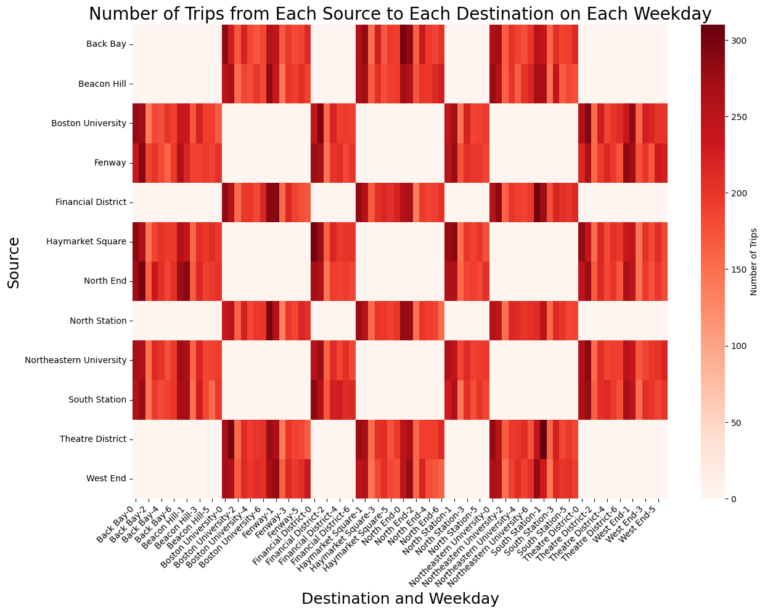
Why Heatmap?
We opted for a heatmap for its ease of visualization and data comprehension.
Depiction:
In the above heatmap, which illustrates the number of trips (both Uber and Lyft) from each source to each destination on weekdays, darker colors signify a higher number of rides, whereas lighter colors indicate a lower number of rides.

Slide 18

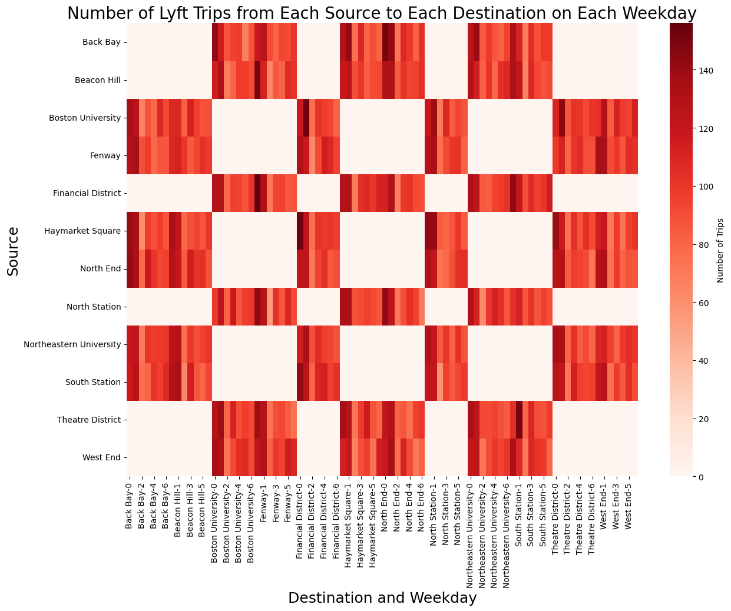
These heatmaps are separate for Uber and Lyft, detailing the number of trips from each source to destination for each ride-sharing service.

Slide 19
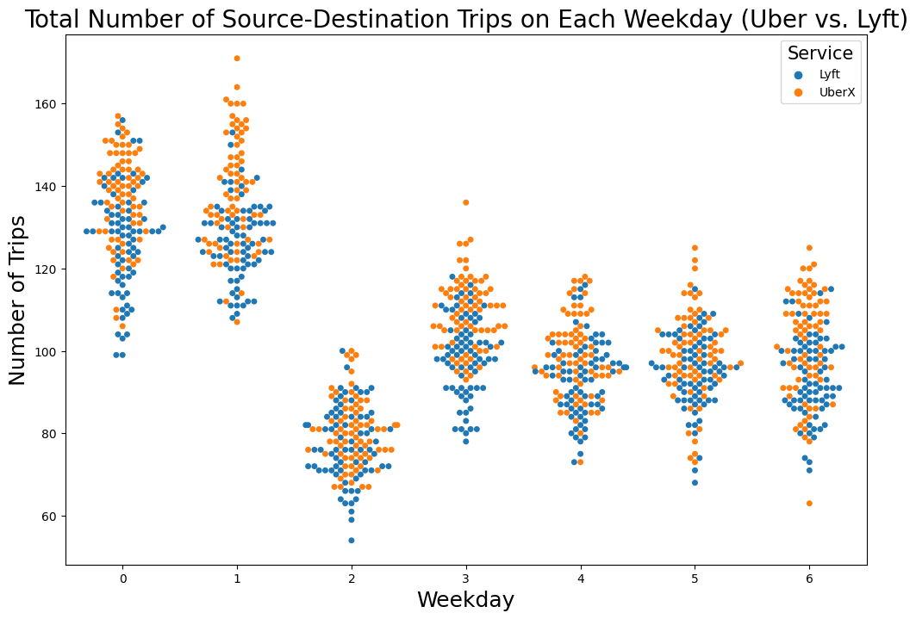
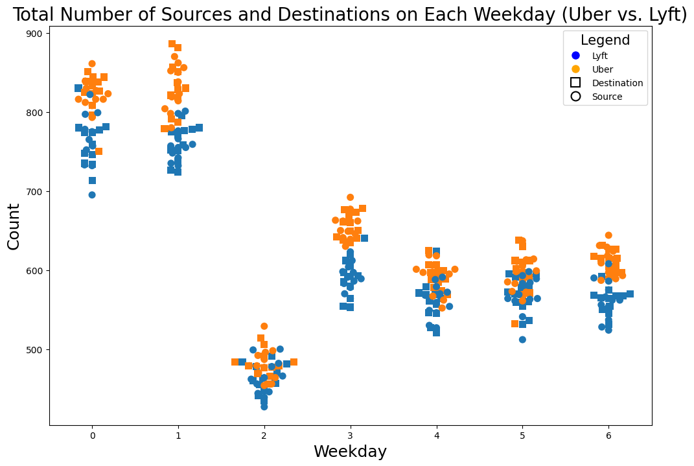
Why Swarm Plot?
We used swarm plot to better understand the data.
Depiction 1:
The plot shows the total number of trips from source to destination for Uber and Lyft on each weekday.
It's easy to see from the graph that Uber has more trips almost every day.
Depiction 2:
Total count of sources and destinations each weekday for both Uber and Lyft.
In the plot, Lyft is represented by blue dots, Uber by orange dots, sources by circles, and destinations by squares.
It's evident from the graph that Uber consistently has a higher number of source-destination pairs each day compared to Lyft.

Slide 20
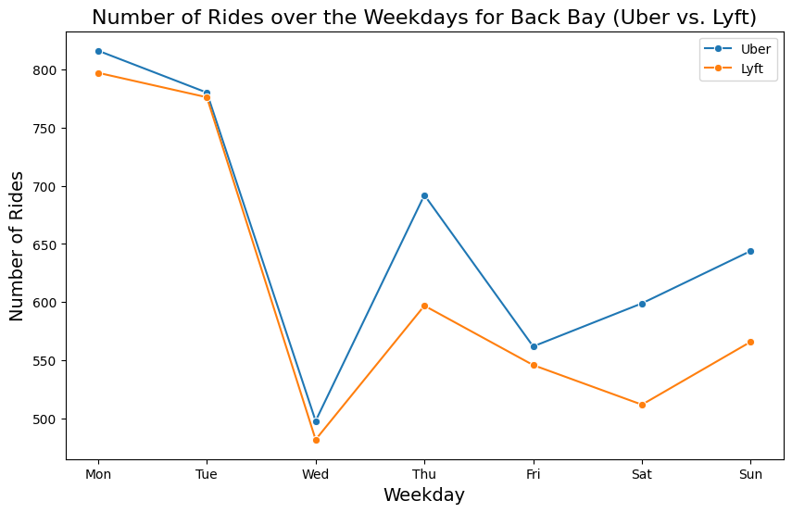
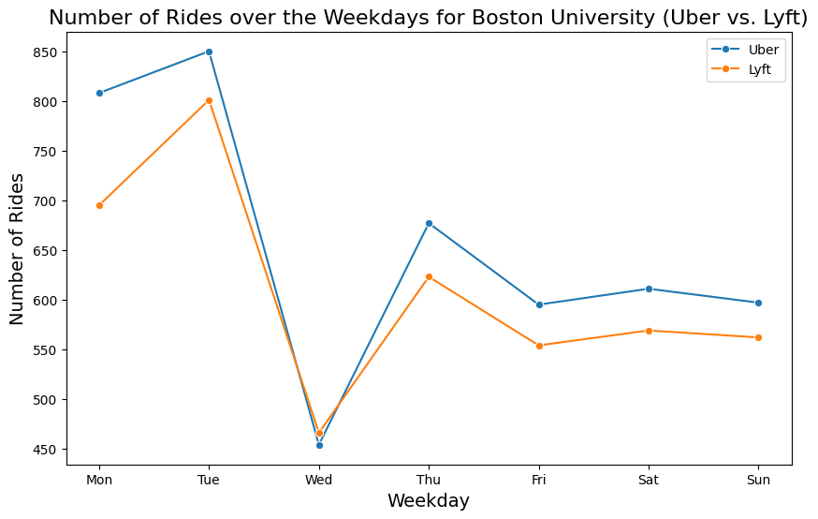
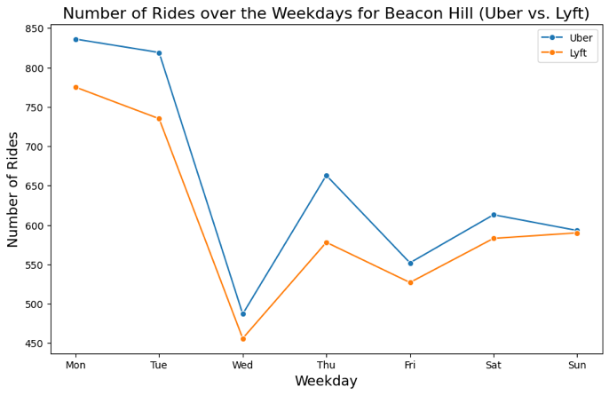
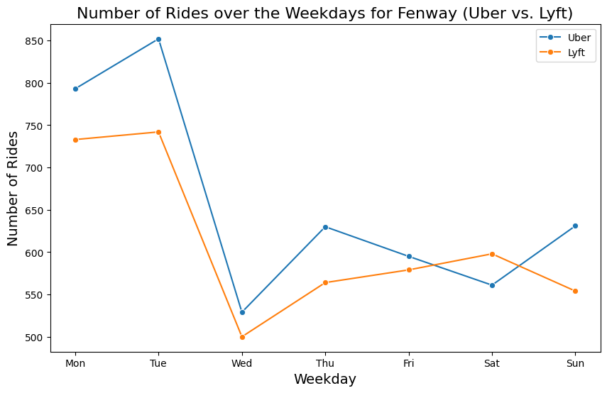

Slide 21
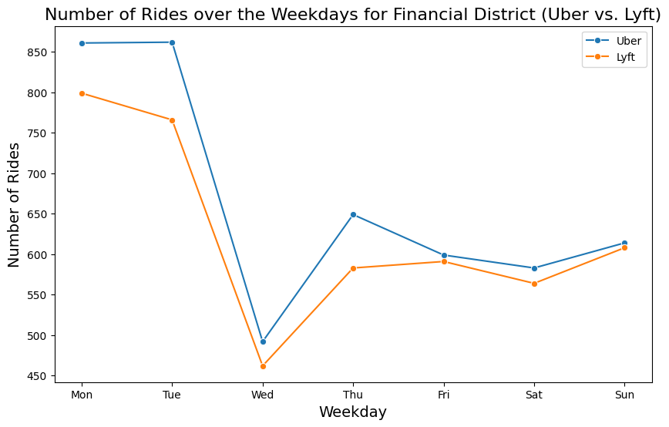
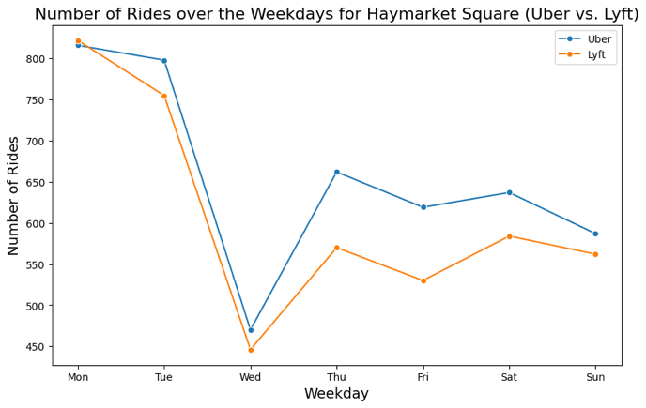
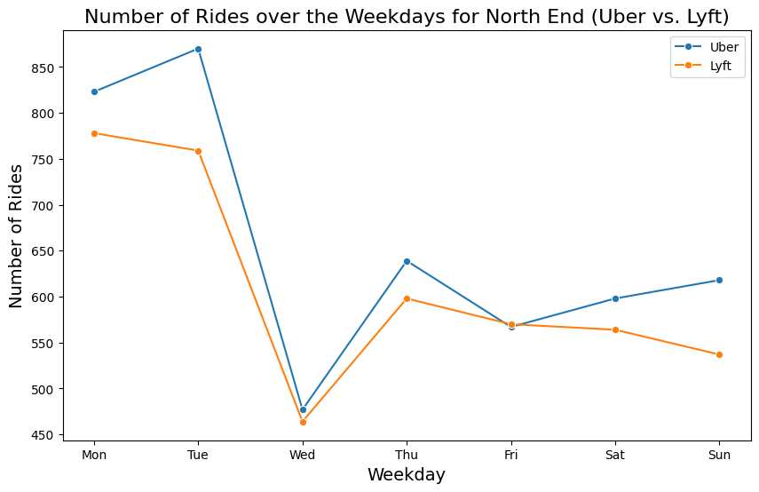
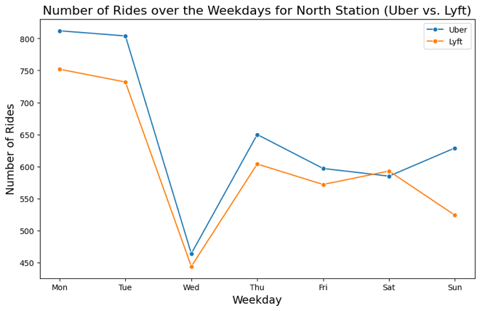

Slide 22
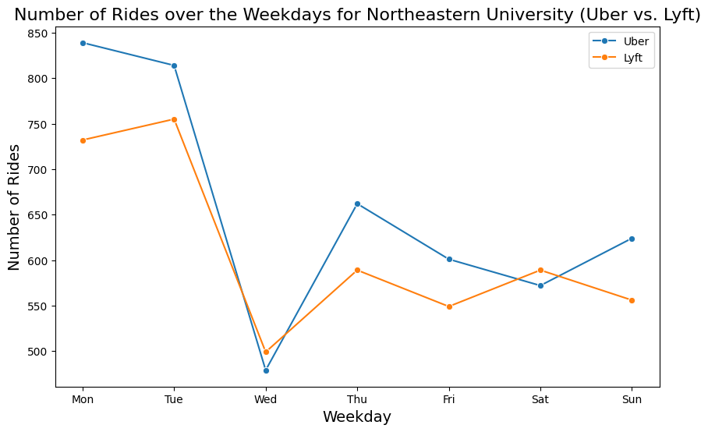
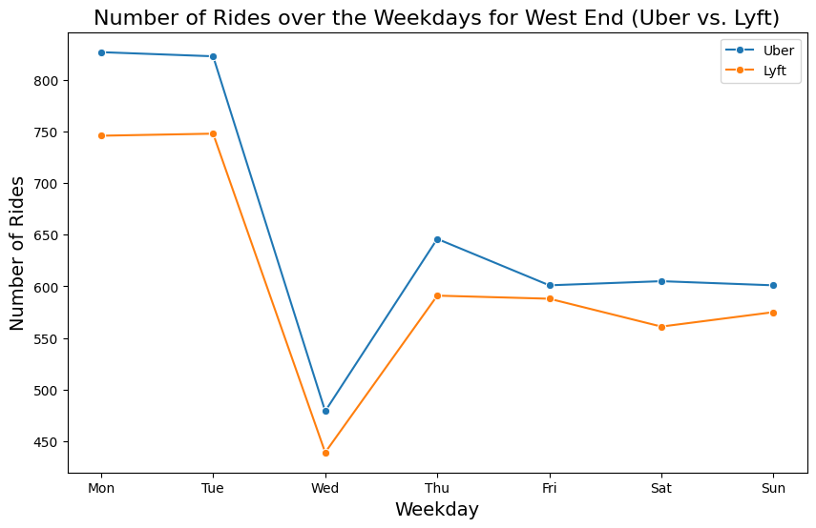
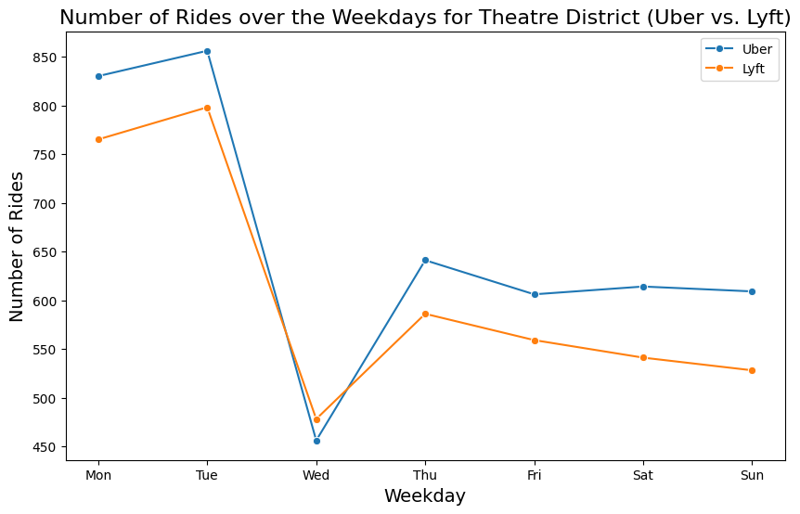
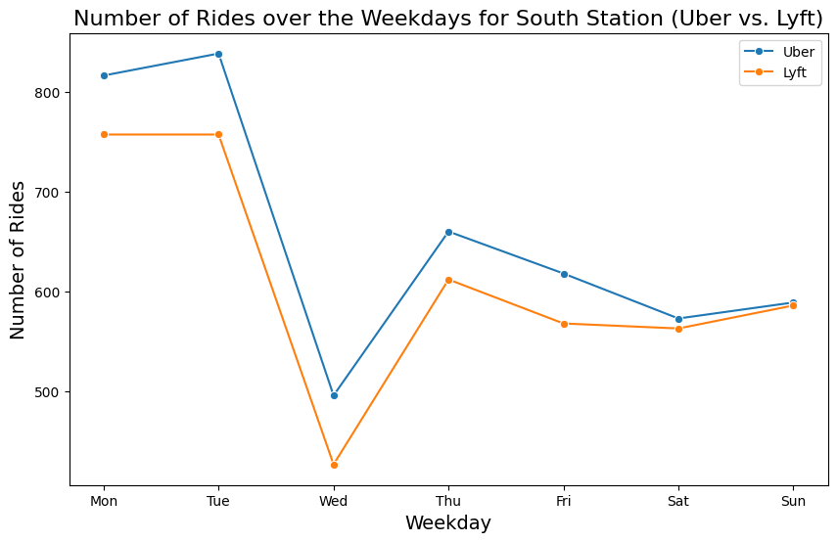
The graphs above represent the number of rides over the weekdays for Uber and Lyft separately. Uber is depicted in blue, while Lyft is shown in orange. Upon examination, it's evident that the number of rides for Uber surpasses that of Lyft for almost every location and on each weekday.

Slide 23
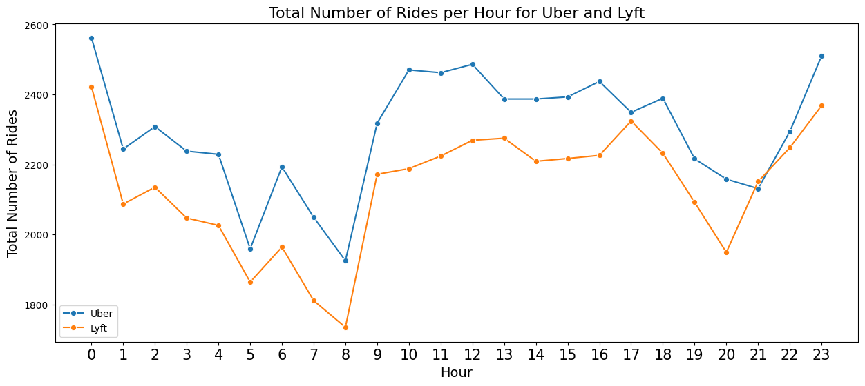
The line plot above depicts the total number of rides per hour for both Uber and Lyft. It's evident from the plot that Uber consistently has a higher number of rides every hour compared to Lyft.

Slide 24
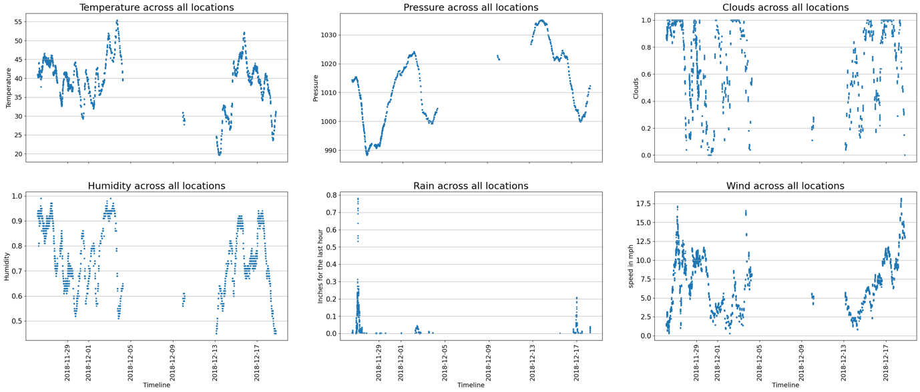
2. Weather Details
The above set of scatter plots visualizes temporal trends in weather data across multiple locations. Each subplot represents a weather parameter (temperature, pressure, clouds, humidity, rainfall, and wind speed), showcasing their variations over time, and aiding in the comprehensive analysis of meteorological patterns.

Slide 25
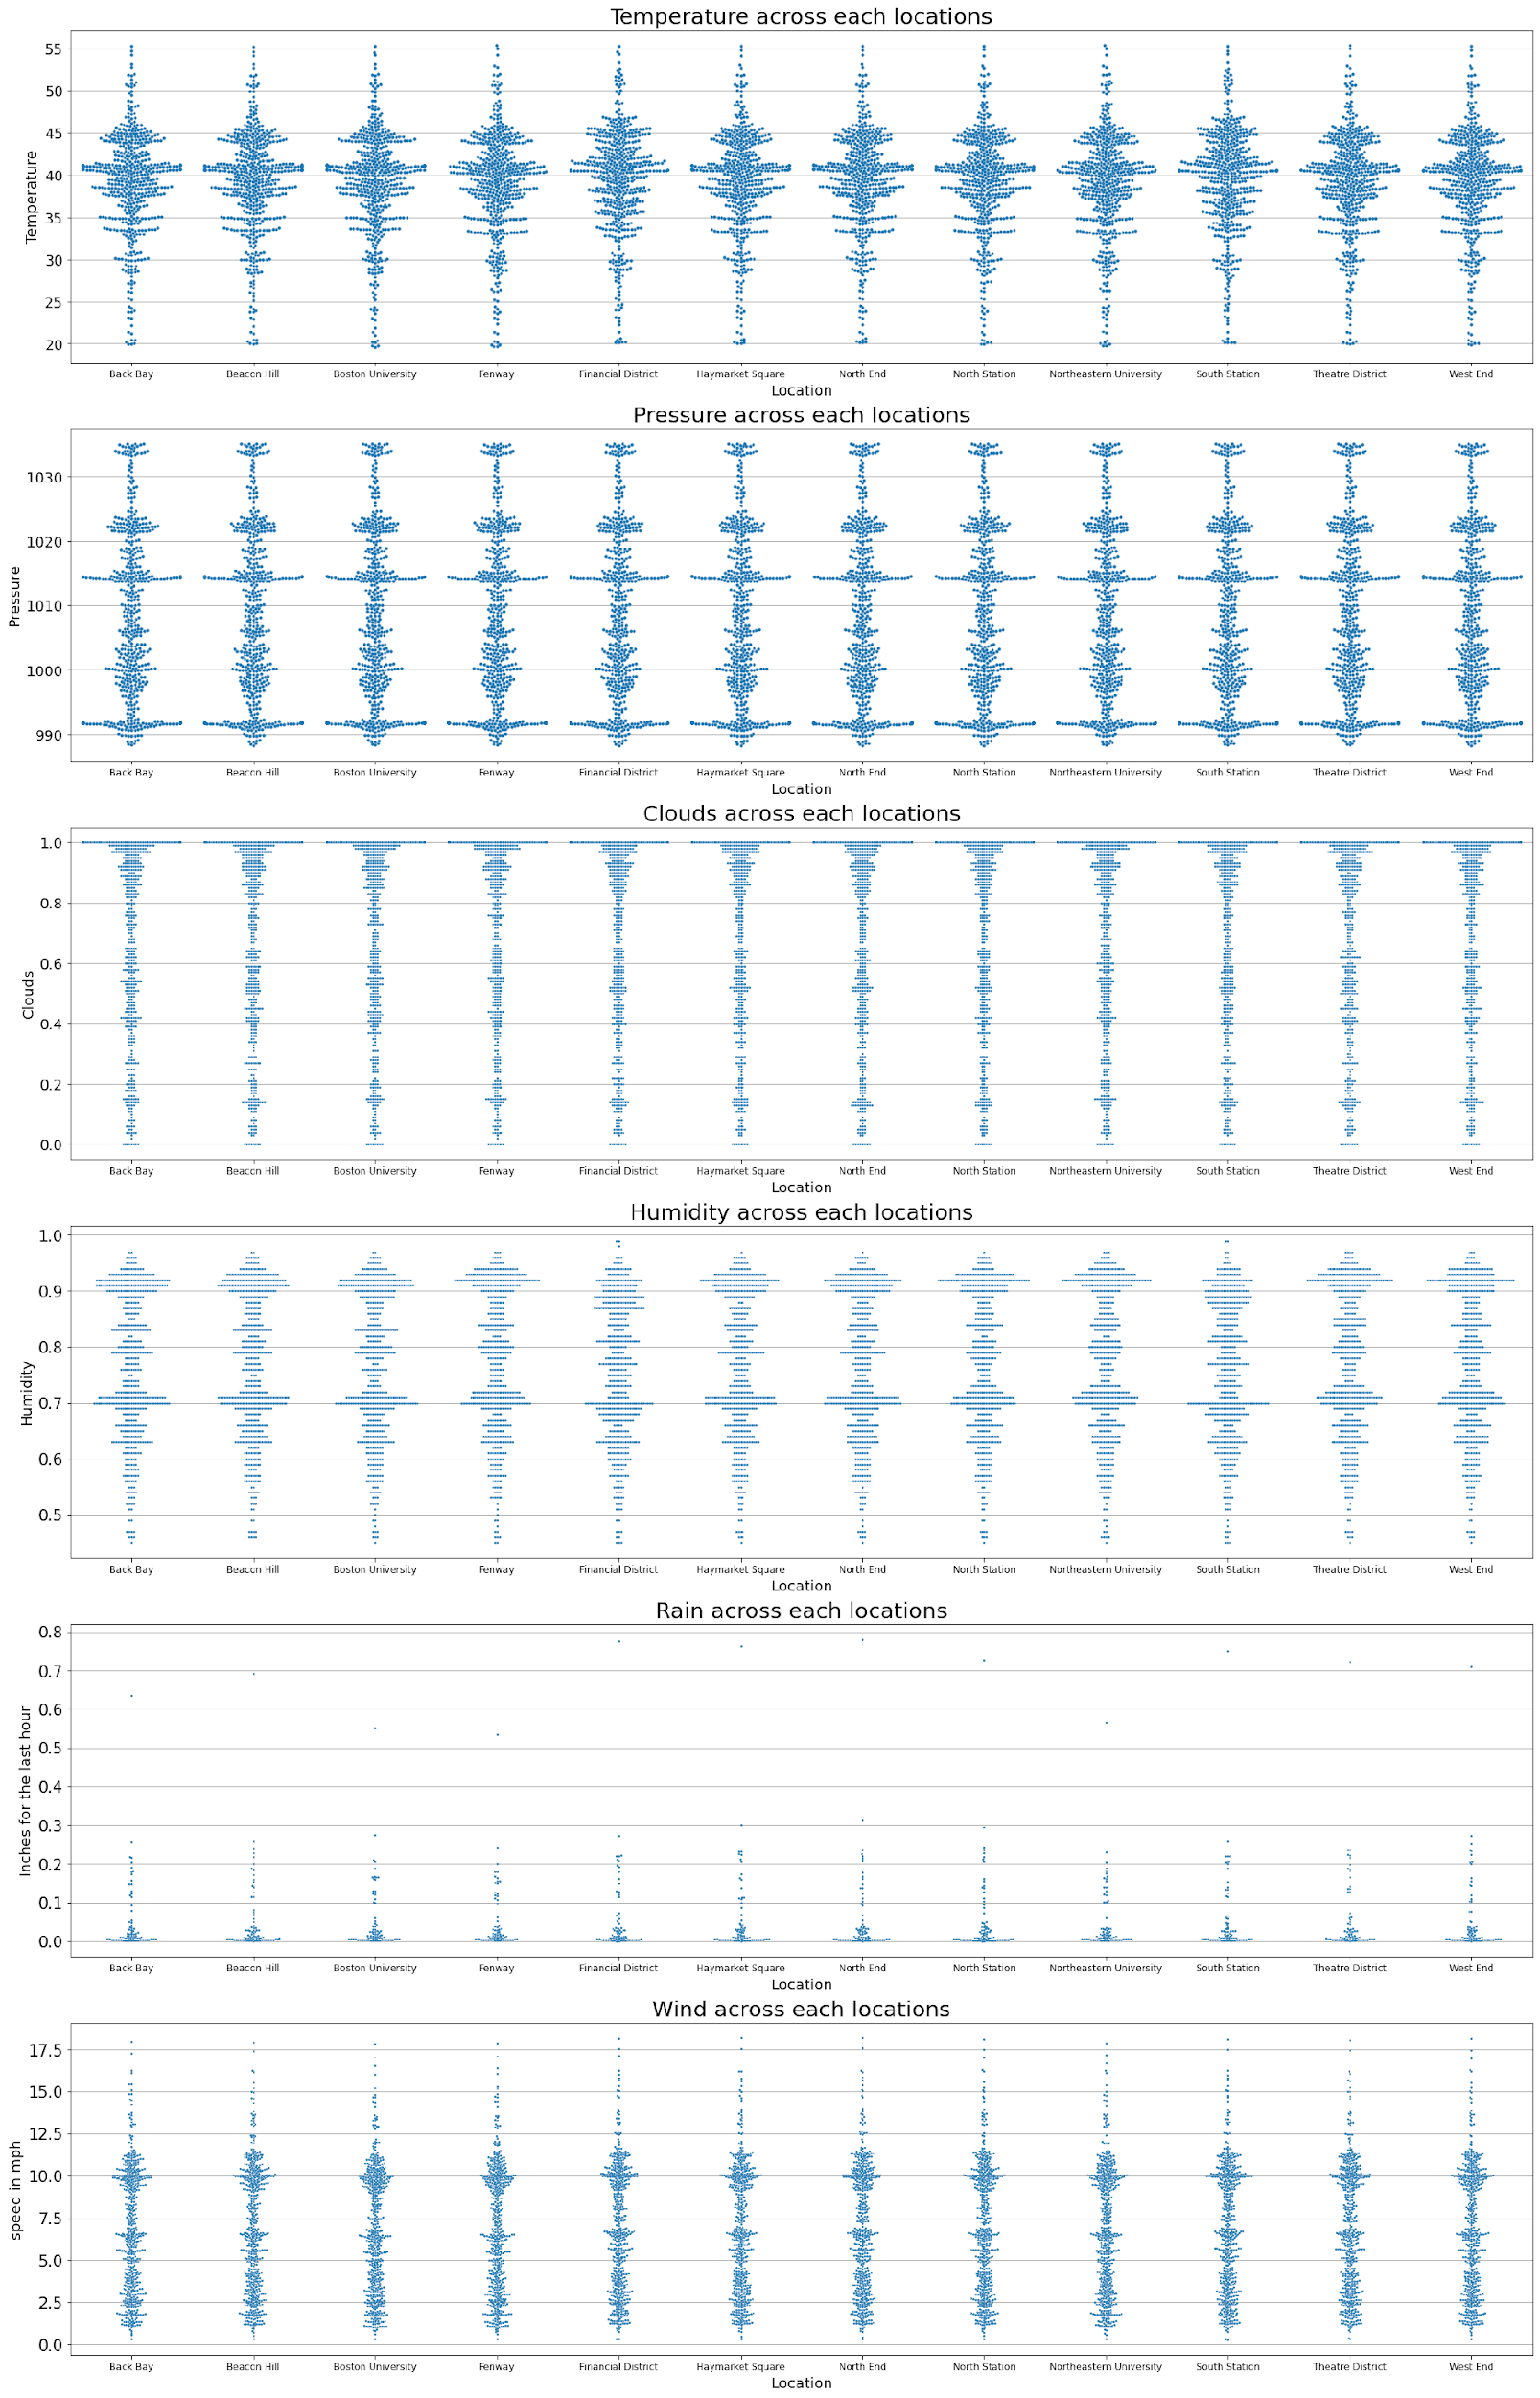
Depiction:
The above layout of swarm plots illustrates weather variations across different locations. Each subplot displays the distribution of temperature, pressure, clouds, humidity, rainfall, and wind speed. The plots aid in comparing and understanding weather patterns for each location individually, providing valuable insights into meteorological conditions.

Slide 26
Exploratory Data Analysis
Data Pre-processing

Slide 27
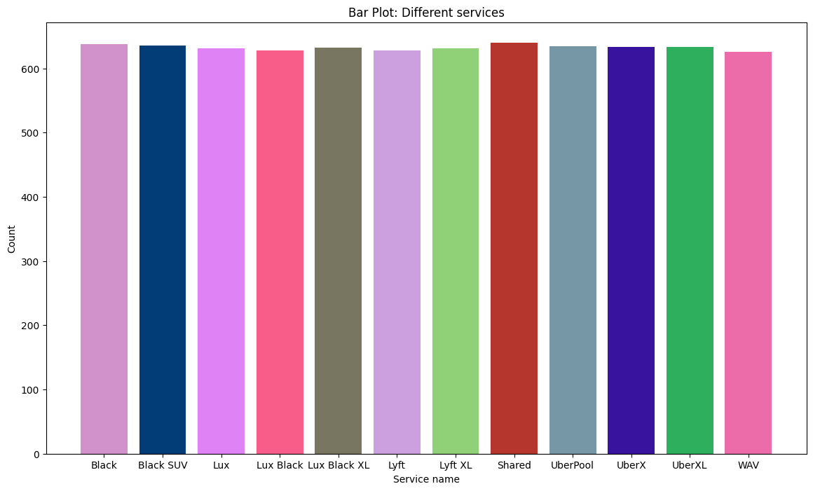
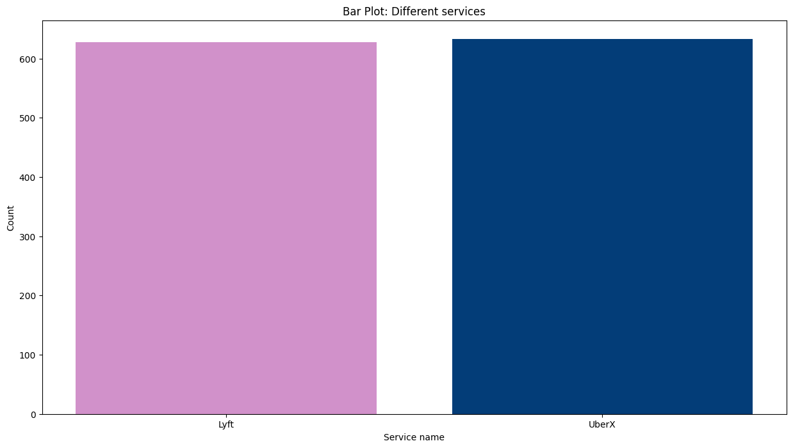
Dataset -1: Rides Dataset
1. Feature extraction:
Extracting Lyft and Uber from the entire dataset, separating and isolating the specific data related to these two entities.

Slide 28
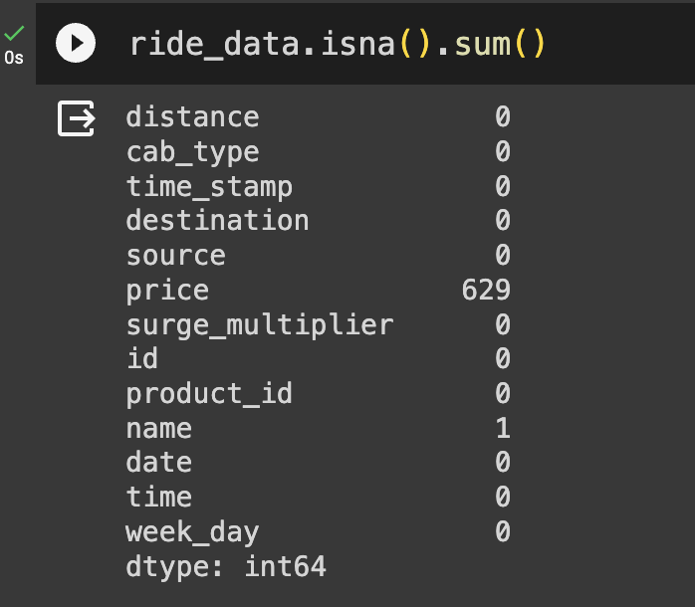
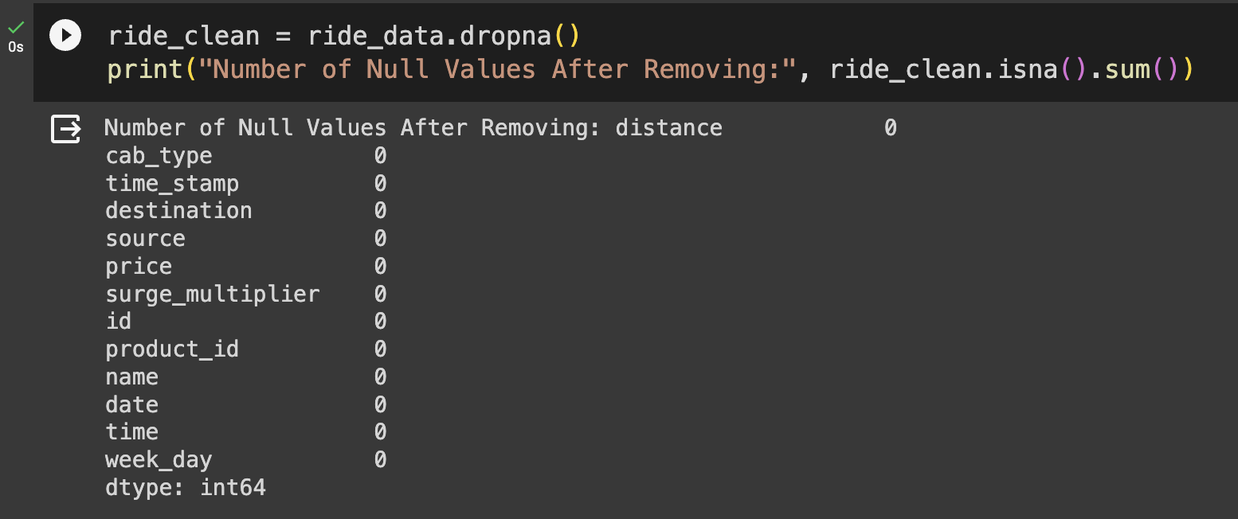
2. Handling missing values:
The "Price" column had some missing values, and we have successfully addressed this by removing all instances of null values from the dataset.

Slide 29
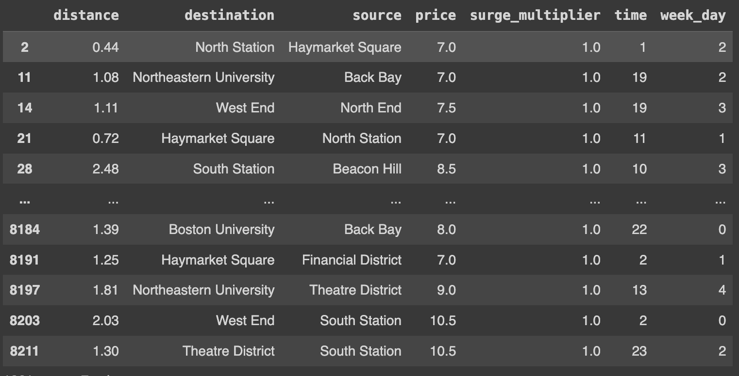
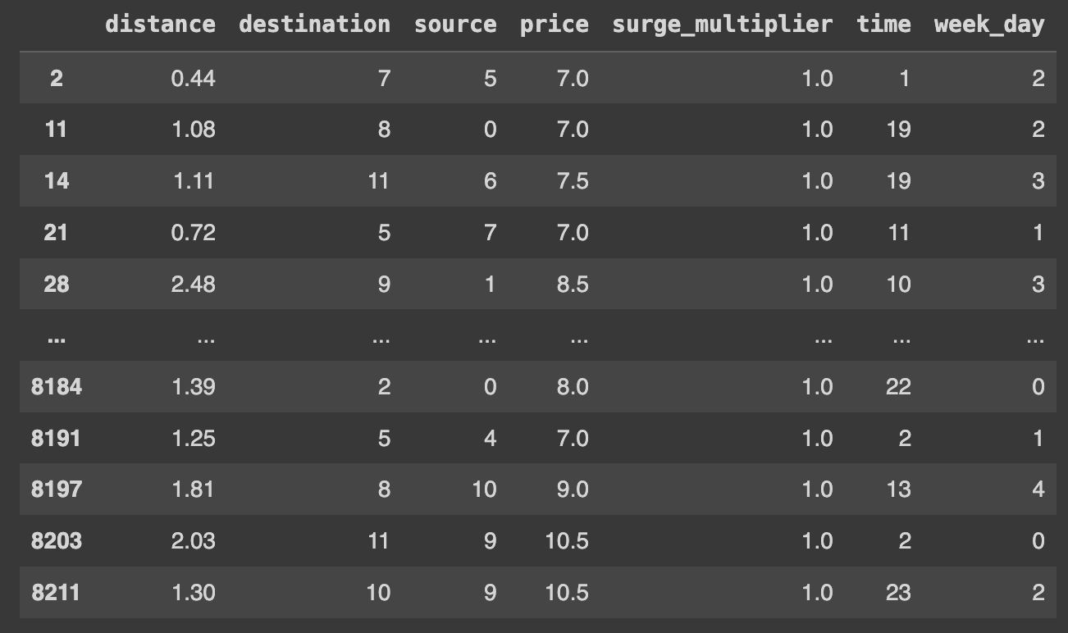
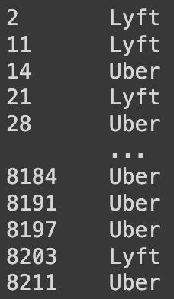
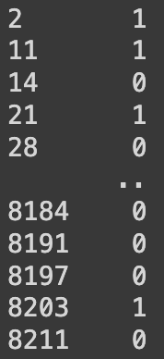
3. Label Encoding:
Source and destination values have been converted to numeric format in the dataset.
The "Cab type" feature has been transformed into numeric values, with Uber represented as 0 and Lyft as 1 in the dataset.

Slide 30
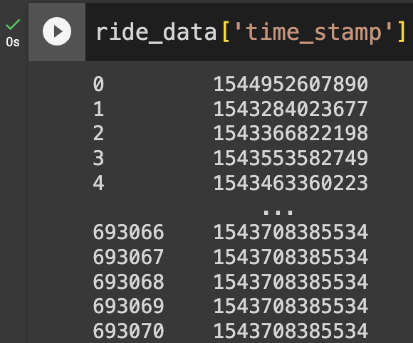
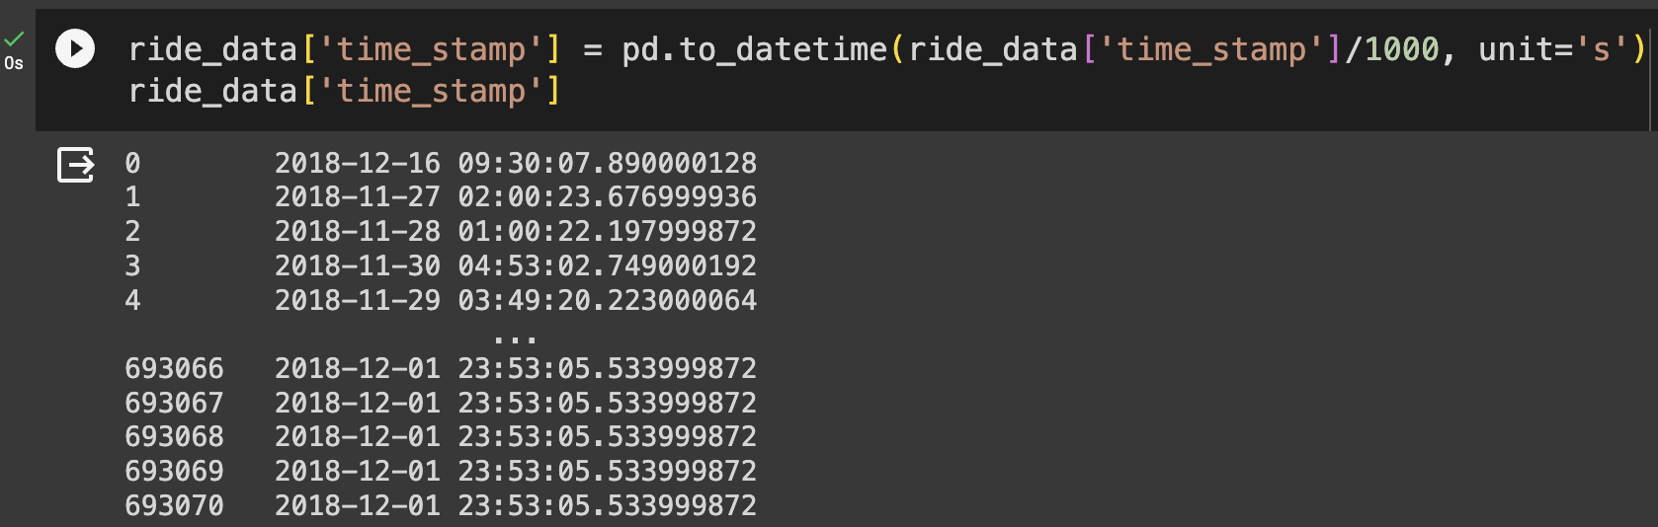
4. Timestamp formatting:
Converting a timestamp to a readable format

Slide 31
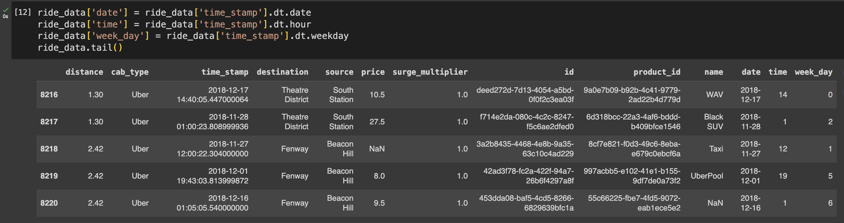
5. Feature engineering:
We are enhancing data understanding by creating new columns—date, time, and weekdays—from the existing.

Slide 32
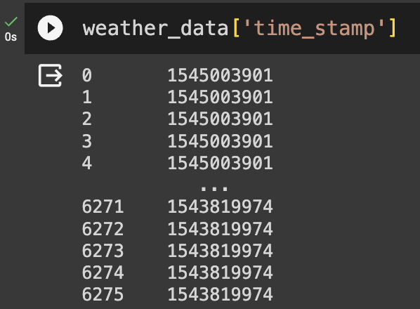
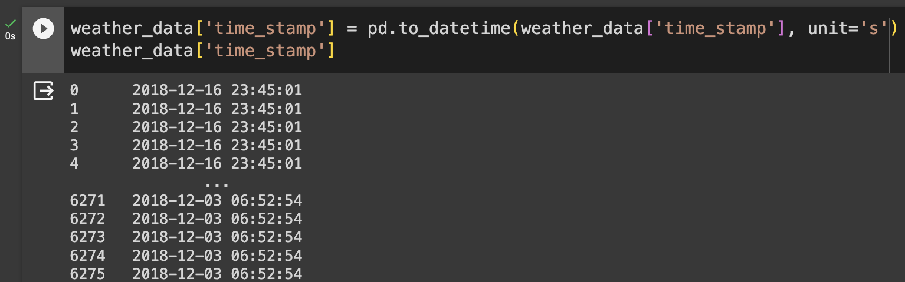
Dataset -2: Weather Dataset
1. Timestamp formatting:
Converting a timestamp to a readable format

Slide 33
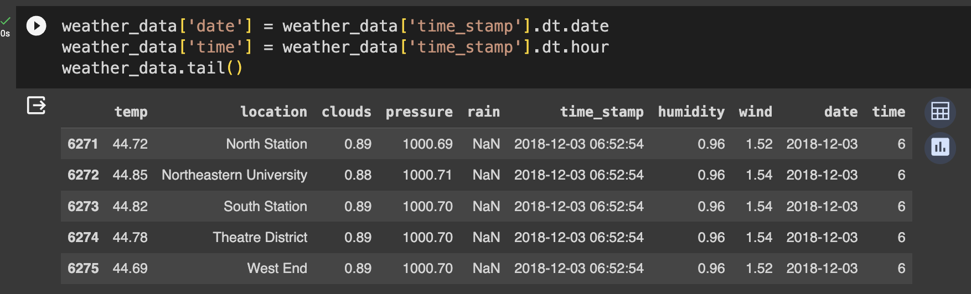
2. Feature engineering:
We are enhancing data understanding by creating new columns—date, time —from the existing timestamp information.

Slide 34
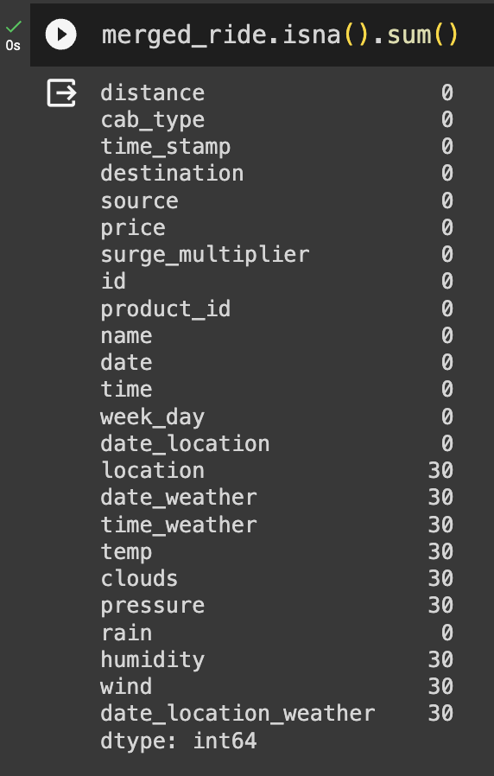
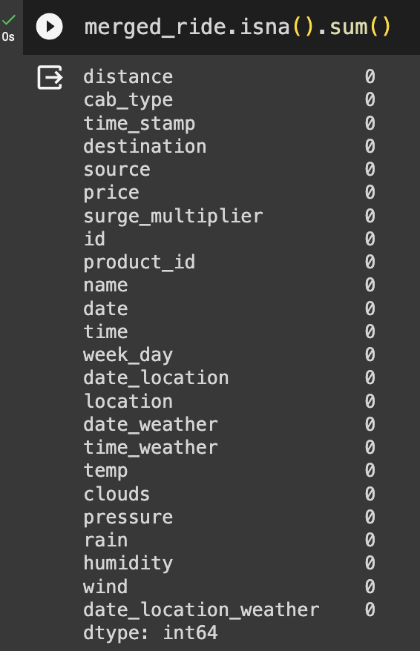
Dataset -3: Merged Dataset
1. Handling missing values:
After merging the datasets, we address missing values by systematically eliminating them through the process of dropping.

Slide 35
Implementation
Algorithm / Pseudocode
Before Merging the dataset

Slide 36


Algorithm-1: SVM
Following preprocessing, the initial algorithm employed is a Support Vector Machine (SVM), known for its efficacy in classifying linear and non-linear data. The dataset was divided into 30% testing and 70% training, utilizing a random state 42. Performance metrics, including accuracy, recall, precision, and F1-score, were computed, resulting in an accuracy of 59%. Additionally, a confusion matrix was generated to further evaluate the model's performance.

Slide 37


Algorithm-2: Logistic Regression
Subsequent to SVM, Logistic Regression was employed, a widely utilized classification algorithm modeling the probability of the target variable. The dataset was divided into 30% for testing and 70% for training, with a random state of 42. Performance metrics were calculated, yielding an accuracy of 50% for the algorithm. Additionally, a confusion matrix was generated to further evaluate the model's performance.

Slide 38


Algorithm-3: KNN
Following Logistic Regression, the K-Nearest Neighbors (KNN) algorithm was applied, recognized for its simplicity and effectiveness in classification based on the majority class of its k-nearest neighbors. The data was split into 30% for testing and 70% for training, using a random state of 42. Performance metrics were then computed, resulting in an accuracy of 72% for the algorithm. Additionally, a confusion matrix was generated to further evaluate the model's performance.

Slide 39


Having achieved the highest accuracy with KNN among the three algorithms, the next step involves hyperparameter tuning to further enhance accuracy.
Following the tuning process with parameters such as
'n_neighbors’: [10, 30, 100, 500],
'weights': ['uniform', 'distance'], and
'metric': ['euclidean', 'manhattan’],
the accuracy improved to 81%. The best hyperparameters determined were {'metric': 'manhattan', 'n_neighbors': 500, 'weights': 'distance'}.

Slide 40
Implementation
Algorithm / Pseudocode
After Merging the dataset

Slide 41

Algorithm-1: SVM
Following the merging of the rides and weather datasets, and subsequent preprocessing, SVM is employed. The data is split into 30% for testing and 70% for training, and performance measures are calculated, resulting in an accuracy of 51%. Additionally, a confusion matrix was generated to further evaluate the model's performance.

Slide 42


Algorithm-2: Logistic Regression
Subsequent to SVM, Logistic Regression was employed. The dataset was divided into 30% for testing and 70% for training, with a random state of 42. Performance metrics were calculated, yielding an accuracy of 52% for the algorithm. Additionally, a confusion matrix was generated to further evaluate the model's performance.

Slide 43


Algorithm-3: KNN
Following Logistic Regression, the K-Nearest Neighbors (KNN) algorithm was applied. The data was split into 30% for testing and 70% for training, using a random state of 42. Performance metrics were then computed, resulting in an accuracy of 56% for the algorithm.

Slide 44


Having achieved the highest accuracy with KNN among the three algorithms, the next step involves hyperparameter tuning to further enhance accuracy.
Following the tuning process with parameters such as
'n_neighbors’: [3, 9, 147, 149, 150],
'weights': ['uniform', 'distance'], and
'metric': ['euclidean', 'manhattan’],
the accuracy improved to 64%. The best hyperparameters determined were {'metric': 'manhattan', 'n_neighbors': 500, 'weights': 'distance'}.

Slide 45
Implementation
Implementation Libraries

Slide 46
Data Visualization Libraries
Visualization Type | Library | Purpose | Functions used
Heatmap Bar Plot | Seaborn | Visualized relationships and patterns in the data | ‘heatmap’, ‘bar plot’
Box Plot | Matplotlib, Seaborn | Investigated the distribution of numerical features | ‘boxplot’
Scatter Plot | Matplotlib, Seaborn | Explored relationships between continuous variables | ‘scatterplot’
Swam Plot | Seaborn | Examined the distribution of data points | ‘swarm plot’
Line Plot | Matplotlib, Seaborn | Illustrated trends and patterns in time-series data | ‘plot’

Slide 47
Algorithm Libraries
Library | Purpose | Usage
NumPy and Pandas | Scikit-learn (sklearn) | Used for data manipulation and preprocessing.
Scikit-learn (sklearn) | A versatile machine learning library that provides simple and efficient tools for data analysis and modeling. | Employed for implementing and training Support Vector Machine (SVM), Logistic Regression, and K-Nearest Neighbors (KNN). Offers a consistent interface for various machine learning algorithms.
SVM - Support Vector Machine | sklearn.svm | Utilized the `SVC` class for SVM implementation. Configured kernel type, regularization parameter, and kernel coefficient.
Logistic Regression | sklearn.linear_model | Leveraged the `LogisticRegression` class for Logistic Regression implementation. Tuned regularization parameters for optimal model performance.
KNN - K-Nearest Neighbors | sklearn.neighbors | Applied the `KNeighborsClassifier` class for KNN implementation. Explored various distance metrics and optimized the number of neighbors.

Slide 48
Results
Performance measures and Visual diagrams

Slide 49
Before Hyperparameter Tuning
Accuracy: 0.5655760934597097
Recall : 0.5526075022872827
Precision : 0.5656823071095006
F1-SCore : 0.5656231389210454
The accuracy of the KNN algorithm, without hyperparameter tuning, is around 56%.
Breakdown of Predictions (Confusion matrix):
True Positives: 9505 instances correctly predicted as positive.
True Negatives: 8456 instances correctly predicted as negative.
False Positives: 6950 instances incorrectly predicted as positive.
False Negatives: 6846 instances incorrectly predicted as negative.

Slide 50
After Hyperparameter Tuning
Best Parameters: {'metric': 'manhattan', 'n_neighbors': 148, 'weights': 'distance'} Accuracy: 0.6744969612998709
Recall: 0.6237093190432623
Precision: 0.6745825507816439
F1-Score: 0.6736047521648824
After performing hyperparameter tuning the accuracy of the KNN algorithm improved to approximately 67%.
Breakdown of Predictions:
True Positives: 11876 instances correctly predicted as positive.
True Negatives: 9544 instances correctly predicted as negative.
False Positives: 4579 instances incorrectly predicted as positive.
False Negatives: 5758 instances incorrectly predicted as negative.

Slide 51
Project Management

Slide 52
1. Work Completed
Completed data preprocessing tasks, including handling missing values and feature engineering.
Implemented SVM, Logistic Regression, and KNN models for classification.
Conducted hyperparameter tuning using GridSearchCV for optimal model performance.
2. Responsibilities
Tasks | Person Responsible
Finding the dataset | Sijo, Kishan, Poojitha
Workflow & architecture diagram, | Kishan, Bhaskar
Data analysis | Poojitha, Bhaskar
Data visualization | Sijo, Kishan
Data preprocessing | Kishan, Poojitha
Algorithm implementation | Sijo, Poojitha, Bhaskar
Hyperparameter | Kishan, Bhaskar
Performance measure | Sijo, Kishan, Bhaskar, Poojitha
PPT | Kishan, Bhaskar, Poojitha

Slide 53
3. Contributions
Person Responsible | Percentage
Sijo Rejigeorge | 25%
Kishan Kumar Zalavadia | 25%
Poojitha Gorantla | 25%
Valapadasu Uday Bhaskar | 25%
4. Issues/Concerns
Finding the time to collaborate has been an issue initially because of differences in everyone's schedules.

Slide 54
References/Bibliography
Class activities,
https://scikit-learn.org/stable/modules/generated/sklearn.svm.SVC.html
https://scikit-learn.org/stable/modules/generated/sklearn.linear_model.LogisticRegression.html
https://scikit-learn.org/stable/modules/generated/sklearn.neighbors.KNeighborsClassifier.html
https://www.analyticsvidhya.com/blog/2021/06/uber-and-lyft-cab-prices-data-analysis-and-visualization/
https://nycdatascience.com/blog/meetup/uber-vs-lyft-price-prediction-machine-learning-model/
https://medium.com/mindtrades-consulting/uber-and-lyft-cab-prices-data-analysis-and-visualization-93aca4596f20

Slide 55
Project Link
Drive Link: https://drive.google.com/drive/folders/1saX0nAf9Xh0qPvRfJvbUjvgndA5M3_3q?usp=sharing
GitHub Link: https://github.com/Kishan-Kumar-Zalavadia/Machine-Learning_Final-Project

Slide 56
Thank you

